Slide 1
Software Design patterns
From Learn C# Design Patterns step by step by Shivprasad Koirala

Slide 2

Road map

Slide 3
Goals
Design Patterns vs Architecture Pattern vs Architecture Style
Design Pattern Definition
My Store Project
Software Architecture: An evolution process
The Entity
Project: Identify entities
Project: Identify relationships
Project: Derive from common class
Technical Context
3 layer architecture (layer vs tier)
Project: Create UI
Putting the S in SOLID
S.R.P. Synonym: Separation of Concerns (S.O.C.)
Project: Further decoupling
Project: P.I.C. pattern for decoupling (Simple factory)
Project: R.I.P. pattern (Replace IF with polymorphism)
I.O.C. a thought, D.I. an implementation
Family Ties: S.R.P., S.O.C., I.O.C. and D.I.
Project: Improving the Factory
Project: Lazy load the Factory
Project: Cloning (Prototype pattern)
Project: Automate Factory with Unity
Project: Abstract classes
Project: Generic Factory
Project: Strategy pattern for Validation
What's next?

Slide 4
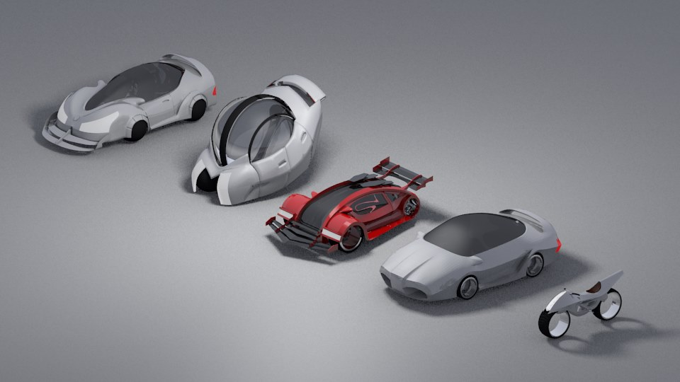
Patterns and concepts covered

Slide 5
S.R.P. and O.C.P.
from Solid
Lazy Loading
Prototype Pattern
Replace IF with
Polymorphism
Strategy Pattern
Inversion of Control
Dependency Injection
Simple Factory

Slide 6

Goals

Slide 7
Why project approach and not example approach?
Design patterns and architecture patterns are thought processes. They are emergent.
Using a project approach, we will see the patterns align naturally along the way.
Notes:
Thought process over example set

Slide 8


Are all design patterns required for good architecture?
Myth: For a good architecture all design patterns have to be implemented in a project.
Fact: Patterns emerge naturally and are completely on-demand

Slide 9

Design Patterns vs Architecture Pattern vs Architecture Style

Slide 10
Are design patterns synonymous with architecture patterns?
Myth: Design patterns and architecture patterns are the same
Fact: Design pattern are at pseudo code level while architecture patterns are at component level.

Slide 11
What is a Pattern?
Notes:
What is a pattern?

Slide 12
pattern [pat-ern; British pat-n]
noun
a natural or chance marking, configuration, or design: patterns of frost on the window.
a distinctive style, model, or form: a new pattern of army helmet.
a combination of qualities, acts, tendencies, etc., forming a consistent or characteristic arrangement: the behaviour patterns of teenagers.
an original or model considered for or deserving of imitation: Our constitution has been a pattern for those of many new republics.
anything fashioned or designed to serve as a model or guide for something to be made: a paper pattern for a dress.
Notes:
Especially number 5.

Slide 13
Attributes of a pattern
They’re Expressive
Common vocabulary
Easier than describing syntax and semantics
Problem agnostic
They’re Proven
Solid
Reliable
Reflect Experience
Represent Insights
They’re Reusable
Out-of-the-box solutions
Flexible
Easily adapted
Help prevent minor issues that can cause major problems later down the line

Slide 14

In the software world, common problems have a specific pattern and many developers have solved these problems and have come out with a solution. Later some of these solutions have proven their worth over a period of time and have become a standard solution for that problem pattern. For example if you want to sort then you have time tested algorithms like bubble sort, inserted sort and so on.
​
Design patterns are at pseudo code level, while architecture patterns are at component level.
Architecture style is a thought process, a one liner principle.
For example REST is a architecture style where we give importance to HTTP.
Notes:
Design Pattern => pseudo code, architecture patterns => component level

Slide 15

Design Pattern - Factory , Iterator , Singleton
Architecture Pattern - MVC, MVP, MVVM
Architecture Style - REST, SOA , IOC

Slide 16
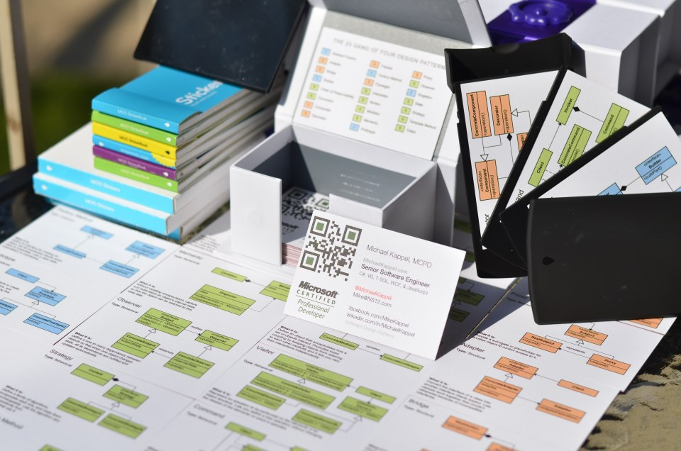
Design Pattern Definition

Slide 17
Official definition for design pattern:
“Time tested Solution for recurring architecture problems”.
​
Koirala states that this definition will not hold true as you start implementing and reading design patterns, but rather that design patterns are all about good O.O.P. ( Object oriented programming) principles, and that the definition will thus become:
"Time tested Solution for recurring OOP problems”.
Notes:
As slide

Slide 18
Design patterns make you a better OOP?
Myth: Design pattern makes you an complete architect.
Fact: Design pattern is one of the things for an architect. It makes you a better OOP.

Slide 19
Design patterns are a way of understanding OOP with scenarios.

Slide 20
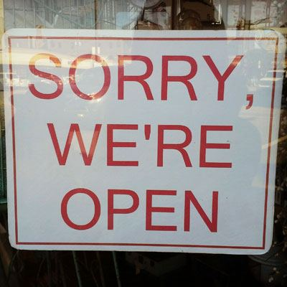
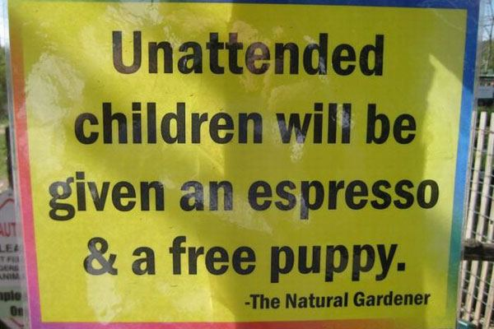
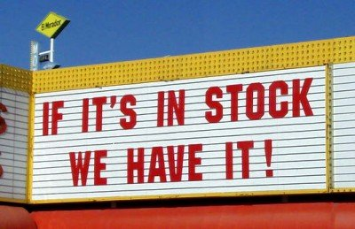
My Store project

Slide 21
As per Koirala's requirements:
My Store is a large retail shopping mall which has chain of mall’s in Johannesburg and Cape Town. The company management wants a simple customer management system for their retail shops with the following features. The company has decided to launch the project in phases.
So in the first phase they just want to capture the customer information. Below is the requirement in more details:
The app must capture 5 fields for now Customer Name, Phone number , Bill Amount , Bill date and Customer Address.
In phase one, two types of customer data are collected. One is a lead and the other is a customer. A lead is a person who comes to My Store but does not buy anything. He just inquires and goes away. A customer is a person who comes and buys things from the shop. A customer actually does a financial transaction.
When it’s a lead, only Customer name and phone number are compulsory, but for a Customer all fields are compulsory. The app should have provision to add new validation rules seamlessly and these validation rules should be flexible and reusable.
The app should have the ability to display, add, update and delete customer data.
For now the system will use a SQL Server and ADO.NET as the data layer technology. However in the coming months we would need to migrate this layer to Entity framework. The migration should be seamless and without many changes across the system.
The app should have the ability of cancelling any modification done on the screen. So if the customer is editing a record and he has changed some values, he should have the opportunity to revert back to the old values.
Notes:
At a glance

Slide 22

Software Architecture: An evolution process
People often try to learn design and architecture by going through code example after code example and pattern description after pattern description. This can be counter intuitive as we only see some academic code and it never really becomes a natural thought process.
So instead let us rather try to architect the above project and let the patterns fall naturally along the way. Pointing them out along the way as they come along.
Thus we'll start first with simple OOP concepts, classes and objects, and let patterns flow forth.
Notes:
Developing a natural thought process. Start with simple OOP concepts, classes and objects.

Slide 23
Architecture needs to be bedded down before code is written?
Myth: Architecture should be perfect and 100% correct from the start.
Fact: Architecture is an evolution. Start small and then keep improving along the way.

Slide 24

The Entity
Things which you see in the real world. These can be identified uniquely. For example a person, place, tangible items etc...
In the OOP world the technical name for entities is objects. The word model is also synonymous with entity.
Notes:
OOP: Entities are objects

Slide 25

Project: Identify entities
Ponder this...
Software code should replicate the real world, real people. For an accountant in the real world, you should have an entity called accountant.
If your code replicates real world objects, you can manage your software in a better and more controlled way.
​
That’s what object oriented programming is all about. Your code should reflect your domain behaviour and domain entities.
​
Domain means the business unit , its rules and how it works.
Notes:
Replicate the real world, code should reflect domain behavior and domain entities

Slide 26
My Store is a large retail shopping mall which has chain of mall’s in Johannesburg and Cape Town. The company management wants a simple customer management system for their retail shops with the following features. The company has decided to launch the project in phases.
In the first phase they just want to capture the customer information. Below is the requirement in more details:
The app must capture 5 fields for now Customer Name, Phone number , Bill Amount , Bill date and Customer Address.
In phase one, two types of customer data are collected. One is a lead and the other is a customer. A lead is a person who comes to My Store but does not buy anything. He just inquires and goes away. A customer is a person who comes and buys things from the shop. A customer actually does a financial transaction.
When it’s a lead, only Customer Name and Phone Number are compulsory, but for a Customer all fields are compulsory. The app should have provision to add new validation rules seamlessly and these validation rules should be flexible and reusable.
The app should have the ability to display, add, update and delete customer data.
For now the system will use a SQL Server and ADO.NET as the data layer technology. However in the coming months we would need to migrate this layer to Entity framework. The migration should be seamless and without many changes across the system.
The app should have the ability of cancelling any modification done on the screen. So if the customer is editing a record and he has changed some values, he should have the opportunity to revert back to the old values.
Notes:
Find the entities…

Slide 27
in identifying entities / objects from the above requirement. We have the following nouns:
Johannesburg
Cape Town
Customer
Lead
My Store
Nouns become entities and verbs become actions for entities. Pronoun becomes the properties and behaviour for those entities.

Slide 28
One of the practices many architects follow is to identify nouns , pronoun and verbs. These nouns are then analysed and identified as objects / entities. However, be careful with this approach because you can end up with unwanted nouns and verbs. Only keep those nouns and verbs that are connected with the final software system.
The above identified entities “Johannesburg ” and “Cape Town ” are city names and have no direct connection with the software as such. “My Store” is the name of the Business Domain and does not have a direct connection to entities within.
So the only useful entities at this point are “Lead” and “Customer”. We will be adding , updating , deleting data around customer.
Notes:
Refine entity list

Slide 29

CLASS
OOP is a three phase process:
Template creation: Create classes and write logic in those classes.
Instantiate: Create entities / objects of these classes and bring them live in memory
Run: Interact with these objects to achieve the software functionality.
OOP Phase | Design pattern category
Template / Class creation problem | Structural design pattern.
Instantiation problems | Creational design pattern.
Runtime problems | Behavioural design pattern.
Notes:
OOP 3 phase process mapped to design pattern categories

Slide 30
Behavioral
Class obj = new Class();
Structural
Creational
Notes:
So how do we start?

Slide 31
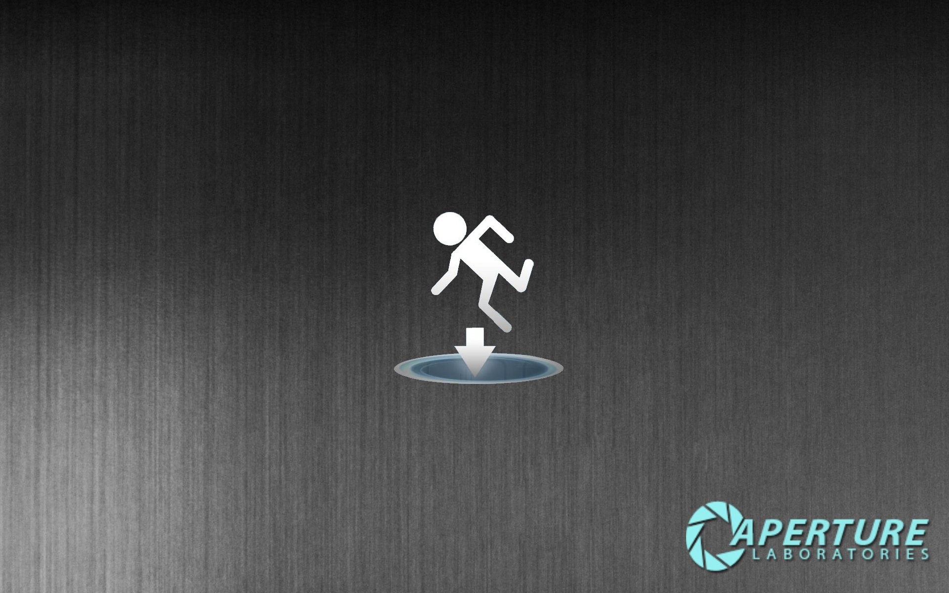
Step one
Start
Test
Code
Refactor
TDD: Write a test

Slide 32
Getting Started
Create a Unit Test project called MyStoreTests.
Add a folder for customer library tests.
Add a unit test class for model tests.

Slide 33

[TestClass]
public class ModelTests
{
public const string TestCustomerName = "TestCustomerName";
public const string TestPhoneNumber = "TestNumber";
public const decimal TestBillAmount = 500m;
public DateTime TestBillDate;
public string TestAddress = "TestAddress";
[TestInitialize]
public void Setup()
{
TestBillDate = DateTime.Now;
}
…

Slide 34
…
[TestMethod]
public void CreatesClassStructureForLeadModel()
{
//Arrange
var sut = new Lead();
//Act
sut.LeadName = TestCustomerName;
sut.PhoneNumber = TestPhoneNumber;
sut.BillAmount = TestBillAmount;
sut.BillDate = TestBillDate;
sut.Address = TestAddress;
//Assert
Assert.IsNotNull(sut);
Assert.AreEqual(TestCustomerName, sut.LeadName);
Assert.AreEqual(TestPhoneNumber, sut.PhoneNumber);
Assert.AreEqual(TestBillDate, sut.BillDate);
Assert.AreEqual(TestBillAmount, sut.BillAmount);
Assert.AreEqual(TestAddress, sut.Address);
}
…
…
[TestMethod]
public void CreatesClassStructureForCustomerModel()
{
//Arrange
var sut = new Customer();
//Act
sut.CustomerName = TestCustomerName;
sut.PhoneNumber = TestPhoneNumber;
sut.BillAmount = TestBillAmount;
sut.BillDate = TestBillDate;
sut.Address = TestAddress;
//Assert
Assert.IsNotNull(sut);
Assert.AreEqual(TestCustomerName, sut.CustomerName);
Assert.AreEqual(TestPhoneNumber, sut.PhoneNumber);
Assert.AreEqual(TestBillDate, sut.BillDate);
Assert.AreEqual(TestBillAmount, sut.BillAmount);
Assert.AreEqual(TestAddress, sut.Address);
}
}
Notes:
Over simplification

Slide 35
Add “CustomerLibrary” class library with the following models:
namespace CustomerLibrary
{
public class Lead
{
public string LeadName { get; set; }
public string PhoneNumber { get; set; }
public decimal BillAmount { get; set; }
public DateTime BillDate { get; set; }
public string Address { get; set; }
}
public class Customer
{
public string CustomerName { get; set; }
public string PhoneNumber { get; set; }
public decimal BillAmount { get; set; }
public DateTime BillDate { get; set; }
public string Address { get; set; }
}
}
Notes:
Create Class Library CustomerLibrary

Slide 36
Project: Identify Relationships
Real world entities interact with each other, they have relationships. So our next step is to identify relationships between entities. If you visualize the relationships that exist in real world, they are of primarily of two types “IS A” and “HAS A”.
For example son “IS A“ child of his father and son “HAS A” a car given to him by his father. “IS A” is more of a parent child relationship (hierarchical) while “HAS A” is more of a using relationship (Aggregated , Composed and Associated).
Notes:
“IS A” => hierarchical, “HAS A” => using relationship

Slide 37
If you read requirement number two…
My Store is a large retail shopping mall which has chain of mall’s in Johannesburg and Cape Town. The company management wants a simple customer management system for their retail shops with the following features. The company has decided to launch the project in phases.
So in the first phase they just want to capture the customer information. Below is the requirement in more details:
The app must capture 5 fields for now Customer Name, Phone number , Bill Amount , Bill date and Customer Address.
In phase one, two types of customer data are collected. One is a lead and the other is a customer. A lead is a person who comes to My Store but does not buy anything. He just inquires and goes away. A customer is a person who comes and buys things from the shop. A customer actually does a financial transaction.
…
Lead IS A type of Customer with less validations
Notes:
PAUSE: Change Lead to inherit from Customer

Slide 38
Update test:
[TestMethod]
public void CreatesClassStructureForLeadModel()
{
//Arrange
var sut = new Lead();
//Act
sut.CustomerName = TestCustomerName;
...
//Assert
Assert.IsNotNull(sut);
Assert.AreEqual(TestCustomerName, sut.CustomerName);
...
}
Customer class becomes:
public class Customer
{
public string CustomerName { get; set; }
public string PhoneNumber { get; set; }
public decimal BillAmount { get; set; }
public DateTime BillDate { get; set; }
public string Address { get; set; }
}
public class Lead : Customer { }

Slide 39
Add Validate method:
[TestMethod]
[ExpectedException(typeof(Exception), "Customer Name is required")]
public void ThrowsExpectionOnCustomerNameLengthZero()
{
//Arrange
var sut= new Customer();
//Act
sut.Validate();
}
public virtual void Validate()
{
if (string.IsNullOrEmpty(CustomerName))
throw new Exception("Customer Name is required");
if (string.IsNullOrEmpty(PhoneNumber))
throw new Exception("Phone number is required");
if (BillAmount > 0)
throw new Exception("Bill is required");
if (BillDate >= DateTime.Now)
throw new Exception("Bill date is not proper");
}

Slide 40
Lead class becomes:
[TestMethod]
public void DoesNotValidateBillAmountOnLead()
{
//Arrange
var sut = new Lead() {CustomerName = TestCustomerName, PhoneNumber = TestPhoneNumber};
//Act
sut.Validate();
//Assert
Assert.AreEqual(0m, sut.BillAmount);
}
public class Lead : Customer
{
public override void Validate()
{
if (string.IsNullOrEmpty(CustomerName))
throw new Exception("Customer Name is required");
if (string.IsNullOrEmpty(PhoneNumber))
throw new Exception("Phone number is required");
}
}
Thought process : “IS A” relationship is a parent child relationship while “HAS A” is a using relationship.
Notes:
But can we take this a step further?

Slide 41

Project: Deriving from a common class

Slide 42
Base Class:
[TestMethod]
public void CreatesClassStructureForLeadModel()
{
//Arrange
CustomerBase sut = new Lead();
...
[TestMethod]
public void CreatesClassStructureForCustomerModel()
{
//Arrange
CustomerBase sut = new Customer();
...
public class CustomerBase
{
public string CustomerName { get; set; }
public string PhoneNumber { get; set; }
public decimal BillAmount { get; set; }
public DateTime BillDate { get; set; }
public string Address { get; set; }
public virtual void Validate()
{
// Let this be defined by the child classes
}
}
I know, no ‘abstract’ keyword, we’ll get to that shortly

Slide 43
Customer and Lead Classes
public class Customer : CustomerBase
{
public override void Validate()
{
if (CustomerName.Length == 0)
throw new Exception("Customer Name is required");
if (PhoneNumber.Length == 0)
throw new Exception("Phone number is required");
if (BillAmount > 0)
throw new Exception("Bill is required");
if (BillDate >= DateTime.Now)
throw new Exception("Bill date is not proper");
}
}
public class Lead : CustomerBase
{
public override void Validate()
{
if (CustomerName.Length == 0)
throw new Exception("Customer Name is required");
if (PhoneNumber.Length == 0)
throw new Exception("Phone number is required");
}
}

Slide 44
Technical context
Consumer Context
Domain
Persistence Context
Windows
Entity
SQL Server
WPF
Entity
Oracle
HTML
Process
Entity
My SQL
Notes:
The above defined three classes are stored in hard disk in the form of “.CS” extensions. Now two things need to be done:-
1) Some UI should invoke these classes , bring these entities live in memory.
2) Second once the end user finishes his operation we need to store these entities in to the hard disk.
In other words our entities need IT infrastructure to run. It needs a UI infrastructure ( WPF, Flash,HTML) for invoking and persistent infrastructure ( Sql Server , Oracle) for saving to hard disk.
If you put a visual picture of thesesections with the technical context it looks something like this. So we can have consumer context which can be in a form of HTML, WPF, Windows etc. We can have persistent context which can be a file or RDBMS like SQL Server, Oracle etc.

Slide 45
Thus we end up with three kinds of sections:
The consumer section which mostly has UI.
The domain section which has your classes and business logic.
The persistence section which is nothing but your RDBMS, file etc.
Thought process: When you visualize a class, remember to see them in both the technical context and business entity context.

Slide 46
3 layer architecture (Layer vs Tier)
The Litmus test of software architecture happens during changes. If a change in one place mean you are making changes in lot of places, that’s a sign of a bad architecture.
So to avoid changes all over place we need to make proper layers and compartments and put similar nature of responsibility in those layers. So from technical context we know we currently have at least three sections: UI ,Domain / Business layer and the Data layer (Persistence).
Business Logic
RDBMS
UI
UI
UI
Etc…
DocDB
Look and Feel
Persistence Logic

Slide 47
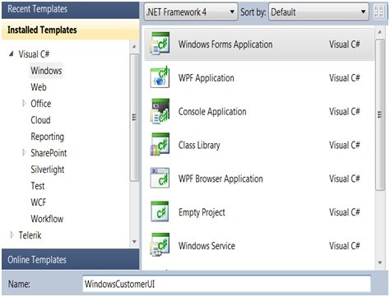
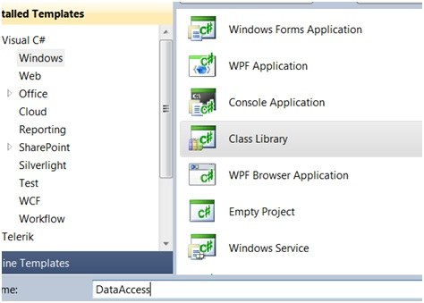
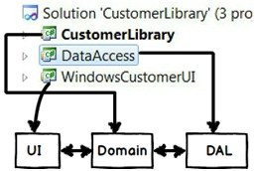
Add UI Layer
Add Persistence Layer
“Three Layer Architecture”
Thought process : Always divide your project in to logical layers and every layer should have some unique responsibly

Slide 48
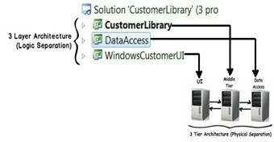
Layer vs Tier

Slide 49
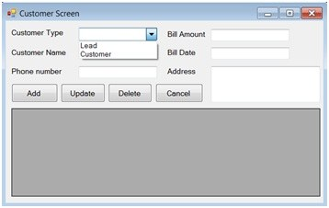
project: Creating user interface

Slide 50
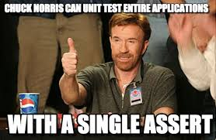

[TestClass]
public class CustomerScreenTests
{
public enum TestCustomerTypes { Lead = 0, Customer = 1}
[TestMethod]
public void AddsnewCustomer()
{
//Arrange
var todayTest = DateTime.Now;
var sut = new FakeCustomerScreen();
sut.SetupValues((int) TestCustomerTypes.Customer, ModelTests.TestCustomerName, ModelTests.TestPhoneNumber,
ModelTests.TestAddress, ModelTests.TestBillAmount, todayTest);
//Act
var result = sut.AddCustomer();
//Assert
var custResult = result as Customer;
Assert.IsNotNull(custResult);
Assert.AreEqual(ModelTests.TestCustomerName, custResult.CustomerName);
Assert.AreEqual(ModelTests.TestPhoneNumber, custResult.PhoneNumber);
Assert.AreEqual(ModelTests.TestAddress, custResult.Address);
Assert.AreEqual(ModelTests.TestBillAmount, custResult.BillAmount);
Assert.AreEqual(todayTest, custResult.BillDate);
}
}
public class FakeCustomerScreen : CustomerScreen
{
public void SetupValues(int customerType, string customerName, string phoneNumber, string address, decimal billAmount,
DateTime billDate)
{
SelectedCustomerType = customerType;
CustomerName = customerName;
PhoneNumber = phoneNumber;
Address = address;
BillAmount = billAmount;
BillDate = billDate;
}
}

Slide 51
public CustomerScreen()
{
InitializeComponent();
}
public int SelectedCustomerType { get { return cbCustomerType.SelectedIndex; } protected set { cbCustomerType.SelectedIndex = value; } }
public string CustomerName { get { return tbCustomerName.Text; } protected set { tbCustomerName.Text = value; } }
public string PhoneNumber { get { return tbPhoneNumber.Text; } protected set { tbPhoneNumber.Text = value; } }
public string Address { get { return tbAddress.Text; } protected set { tbAddress.Text = value; } }
public decimal BillAmount { get { return Convert.ToDecimal(tbBillAmount.Text); }
protected set { tbBillAmount.Text = value.ToString(CultureInfo.InvariantCulture); } }
public DateTime BillDate { get { return dtBillDate.Value; } protected set { dtBillDate.Value = value; } }
public CustomerBase AddCustomer()
{
CustomerBase custBase;
if (cbCustomerType.SelectedIndex == 0)
{
custBase = new Lead();
}
else
{
custBase = new Customer();
}
custBase.CustomerName = CustomerName;
custBase.PhoneNumber = PhoneNumber;
custBase.Address = Address;
custBase.BillAmount = BillAmount;
custBase.BillDate = BillDate;
return custBase;
}
private void btnAdd_Click(object sender, EventArgs e)
{
var newCustomer = AddCustomer();
}
What if new classes are added?
What is the problem with the above code ?

Slide 52
Putting the S in solid
Single Responsibility principle ( SRP)
Open close principle (OCP)
Liskov Substitution Principle ( LSP )
Interface segregation principle ( ISP)
Dependency inversion principle

Slide 53
Single responsibility principle (srp)
SRP says that a class should be responsible for only one thing. UI is supposed to be responsible for visuals aspects: layout, take inputs and so on. However, here it is creating a “Customer” object which is not it’s duty.
In other words the UI is handling multiple responsibilities which makes the class more complex and less maintainable going forward.
Thought process : Keep SOLID principles in mind when you are doing architecting.

Slide 54
Single Responsibility Principle
Separation of Concerns
Higher Cohesion

Slide 55
Project: further decoupling
In order to achieve decoupling between the UI and the Customer types, the UI has to see the Customer types in an abstract way rather than dealing with concrete classes.
Abstraction: OOP principle where we show only necessary things to the consumer.

Slide 56
Interfaces
Add new Class Library: CustomerInterface
Add ICustomer:
public interface ICustomer
{
string CustomerName { get; set; }
string PhoneNumber { get; set; }
decimal BillAmount { get; set; }
DateTime BillDate { get; set; }
string Address { get; set; } void Validate();
}

Slide 57
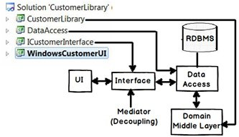
Project structure should now look like:

Slide 58
public ICustomer AddCustomer()
{
ICustomer custBase;
if (cbCustomerType.SelectedIndex == 0)
{
custBase = new Lead();
}
else
{
custBase = new Customer();
}
custBase.CustomerName = CustomerName;
custBase.PhoneNumber = PhoneNumber;
custBase.Address = Address;
custBase.BillAmount = BillAmount;
custBase.BillDate = BillDate;
return custBase;
}
Nothing has really changed
Thought process : The primary work of interfaces is to decouple classes from each other.

Slide 59
Project: P.i.c. pattern for decoupling
“NEW” keyword one of the prime reason why two systems are tightly coupled:
[TestClass]
public class FactoryTests
{
[TestMethod]
public void CreatesNewLeadInstance()
{
//Arrange
var sut = new Factory();
//Act
var result = sut.Create((int)CustomerScreenTests
.TestCustomerTypes.Lead);
//Assert
var leadResult = result as Lead;
Assert.IsNotNull(leadResult);
}
[TestMethod]
public void CreatesNewCustomerInstance()
{
//Arrange
var sut = new Factory();
//Act
var result = sut.Create((int)CustomerScreenTests
.TestCustomerTypes.Customer);
//Assert
var leadResult = result as Customer;
Assert.IsNotNull(leadResult);
}
}
P.I.C.: “Polymorphism + Interfaces + Centralizing object creation”

Slide 60
Project: P.i.c. pattern for decoupling
Add new Class Library: CustomerFactory
Add Factory:
public class Factory
{
public ICustomer Create(int CustomerType)
{
if (CustomerType == 0)
{
return new Lead();
}
else
{
return new Customer();
}
}
}

Slide 61

So now the UI uses the “Factory” to create objects and because the “Create” function returns an “ICustomer” type, it does not have to worry about the concrete customer classes.
ICustomer icust = null;
Factory obj = new Factory();
icust = obj.Create(cmbCustomerType.SelectedIndex);
Thought process: “NEW” keyword is the main culprit for tight coupling.
Notes:
At this point, the CustomerLibrary reference can be removed from the UI Project

Slide 62
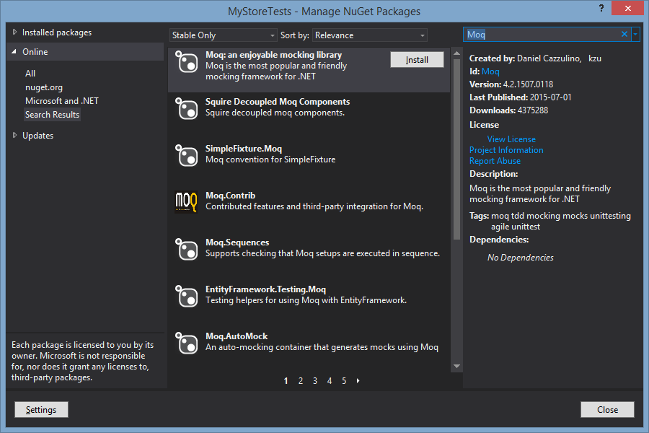
Test only one thing
Moq: The other white meat:

Slide 63

1) Update CustomerScreenTests Class with the following:
private Mock<Factory> _mockFactory;
[TestInitialize]
public void Setup()
{
_mockFactory = new Mock<Factory>();
_mockFactory.Setup(f => f.Create((int) TestCustomerTypes.Lead)).Returns(new Lead());
_mockFactory.Setup(f => f.Create((int) TestCustomerTypes.Customer)).Returns(new Customer());
}
2) Add a Constructor to the FakeCustomerScreen class:
public FakeCustomerScreen(Factory factory)
{
Factory = factory;
}

Slide 64
3) Add a Property for the Factory to the Customer Screen:
public Factory Factory
{
get { return _factory ?? (_factory = new Factory()); }
protected set { _factory = value; }
}
4) AddCustomer Method becomes:
public ICustomer AddCustomer()
{
var icust = Factory.Create(SelectedCustomerType);
icust.CustomerName = CustomerName;
icust.PhoneNumber = PhoneNumber;
icust.Address = Address;
icust.BillAmount = BillAmount;
icust.BillDate = BillDate;
return icust;
}

Slide 65
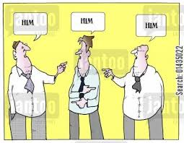
Project: r.i.p. pattern
What we currently have:
Centralized
IF
UI
UI
Factory
Other Client
Factory
Concrete Classes
Other Consumer
Let’s start thinking how we can remove the “IF” condition. Best practice statement:
“If there is polymorphism and if you see lots of IF conditions that means polymorphism benefit is not exploited”.
R.I.P.: Replace “IF” with “Polymorphism”

Slide 66
Update Factory class:
1) Create a list of collection of “ICustomer”.
private readonly List<ICustomer> _customers = new List<ICustomer>();
2) In the constructor load the types of customer classes like lead and customer.
public Factory()
{
_customers.Add(new Lead());
_customers.Add(new Customer());
}
3) The create method just look’s up the list by index and returns type of customer. Because of polymorphism the concrete customer classes gets automatically type casted to a generic interface.
public ICustomer Create(int CustomerType)
{
return _customers[CustomerType];
}

Slide 67
Full Factory Class:
public class Factory
{
private readonly List<ICustomer> _customers = new List<ICustomer>();
public Factory()
{
_customers.Add(new Lead());
_customers.Add(new Customer());
}
public ICustomer Create(int CustomerType)
{
return _customers[CustomerType];
}
}
The biggest constraint of the R.I.P. pattern is that the concrete classes should be in an inheritance hierarchy and have the same signatures. Polymorphism and Inheritance are compulsory features for the R.I.P. pattern.
Thought process: In Polymorphism IF can be replaced with a dynamic polymorphic collection.

Slide 68
I.o.c.: a thought, d.i. an implementation
I.O.C. is the principle of moving ‘unwanted’ responsibility to another entity. The responsibility of the Customer object creation was moved out to the Factory. This can be done in multiple ways: D.I., Delegates, and so on.
Creation inverted or moved
D.I. is the process of injecting the dependent objects from a separate entity to achieve decoupling.
UI
Factory
Objects injected
I.o.C.: “Inversion of Control” D.I.: “Dependency Injection”

Slide 69
Family ties: S.r.p., s.o.c., i.o.c. and d.i.
IOC
DI
SL
Events
Thought process
SRP
SOC
Delegates
Implementations
SL: Service Locator

Slide 70
Dependency Injection vs Service Locator
Dependency Injection
Service Locator
//Foo Needs an IBar
public class Foo
{
private IBar bar;
public Foo(IBar bar)
{
this.bar = bar;
}
//...
}
//Foo Needs an IBar
public class Foo
{
private IBar bar;
public Foo()
{
this.bar = Container.Get<IBar>();
}
//...
}
http://martinfowler.com/articles/injection.html

Slide 71
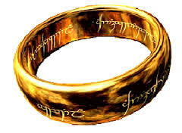
Project: improving the factory
What if we need lots of concrete objects?
We can create ONE instance of the factory class with all concrete objects loaded once.
To achieve this we do the following:
Declare the class as static.
Declare the list in which the types will be stored as static.
Finally the Create function should also be defined as static so that it can access static variables.

Slide 72
Update Unit Tests:
[TestClass]
public class FactoryTests
{
[TestMethod]
public void CreatesNewLeadInstance()
{
//Arrange
//Act
var result = Factory.Create((int)CustomerScreenTests.TestCustomerTypes.Lead);
//Assert
var leadResult = result as Lead;
Assert.IsNotNull(leadResult);
}
[TestMethod]
public void CreatesNewCustomerInstance()
{
//Arrange
//Act
var result = Factory.Create((int)CustomerScreenTests.TestCustomerTypes.Customer);
//Assert
var leadResult = result as Customer;
Assert.IsNotNull(leadResult);
}
}

Slide 73
Factory Class:
public static class Factory
{
private readonly static List<ICustomer> Customers = new List<ICustomer>();
static Factory()
{
Customers.Add(new Lead());
Customers.Add(new Customer());
}
public static ICustomer Create(int CustomerType)
{
return Customers[CustomerType];
}
}

Slide 74
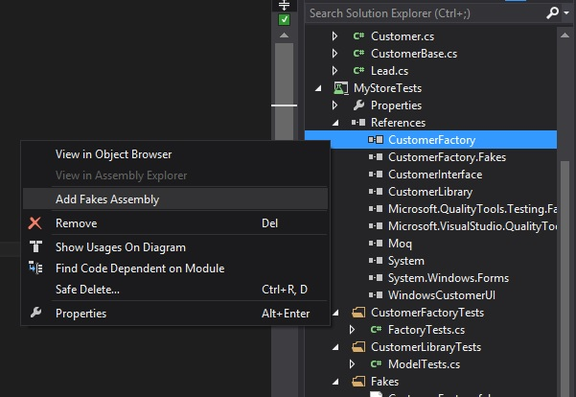
Unit testing fakes and shims

Slide 75
Customer Screen tests updated using Shims to replace the instance of the Static class:
[TestMethod]
public void AddsnewCustomer()
{
//Arrange
var todayTest = DateTime.Now;
using (ShimsContext.Create())
{
//Arrange
var sut = new FakeCustomerScreen();
sut.SetupValues((int)TestCustomerTypes.Customer, ModelTests.TestCustomerName, ModelTests.TestPhoneNumber, ModelTests.TestAddress, ModelTests.TestBillAmount, todayTest);
ShimFactory.CreateInt32 = custType => new Customer();
//Act
var result = sut.AddCustomer();
//Assert
var custResult = result as Customer;
Assert.IsNotNull(custResult);
Assert.AreEqual(ModelTests.TestCustomerName, custResult.CustomerName);
Assert.AreEqual(ModelTests.TestPhoneNumber, custResult.PhoneNumber);
Assert.AreEqual(ModelTests.TestAddress, custResult.Address);
Assert.AreEqual(ModelTests.TestBillAmount, custResult.BillAmount);
Assert.AreEqual(todayTest, custResult.BillDate);
}
}

Slide 76
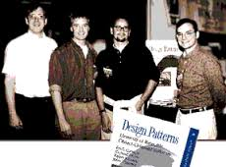
UI calling code:
icust = Factory.Create(cmbCustomerType.SelectedIndex);
Not be confused with the gang of four Factory pattern. The base of this Factory pattern is the simple factory pattern.

Slide 77
Project: Lazy load the factory
If we have a lot of different types of possible objects, including obscure types, we are still loading an instance of them up front whether we need them or not.
Here we are going to load them on demand.
1) Make the object collection types null.
private static List<ICustomer> customers = null;
2) Change the Create function to first check if the object is NULL then load it or else just lookup in the collection.
public static ICustomer Create(int CustomerType)
{
if (customers == null)
{
LoadCustomers();
}
return customers[CustomerType];
}

Slide 78
public static class Factory
{
private static List<ICustomer> customers = null;
private static void LoadCustomers()
{
customers = new List<ICustomer>();
customers.Add(new Lead());
customers.Add(new Customer());
}
public static ICustomer Create(int CustomerType)
{
if (customers == null)
{
LoadCustomers();
}
return customers[CustomerType];
}
}
Lazy Loading pattern: This is a creational design pattern where we load objects only when we need it. The opposite of Lazy loading is eager loading.

Slide 79
Using the Lazy<> keyword:
public static class Factory
{
private static readonly Lazy<List<ICustomer>> Customers = null;
static Factory()
{
Customers = new Lazy<List<ICustomer>>(() => LoadCustomers());
}
private static List<ICustomer> LoadCustomers()
{
return new List<ICustomer>() { new Lead(), new Customer() };
}
public static ICustomer Create(int customerType)
{
return Customers.Value[customerType];
}
}

Slide 80
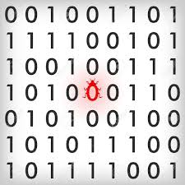
Project: cloning (prototype pattern)
There a defect lurking in the Factory class, What is it?
var Icust = Factory.Create(0);
Icust.CustomerName = “Dave”;
var icustNew = Factory.Create(0);

Slide 81

Cloning
1) Write a test for duplicates:
[TestMethod]
public void CreatesFreshCloneofCustomerFromFactory()
{
//Arrange
//Act
var firstResult = Factory.Create((int) CustomerScreenTests.TestCustomerTypes.Customer);
var secondResult = Factory.Create((int) CustomerScreenTests.TestCustomerTypes.Customer);
//Assert
Assert.AreNotSame(firstResult, secondResult);
}

Slide 82
2) Define a “Clone” method in the “ICustomer” interface:
public interface ICustomer
{
string CustomerName { get; set; }
string PhoneNumber { get; set; }
decimal BillAmount { get; set; }
DateTime BillDate { get; set; }
string Address { get; set; }
void Validate();
ICustomer Clone(); // Added an extra method clone
}
3) Using MemberwiseClone on CustomerBase:
public class CustomerBase : ICustomer
{
// Other codes removed for readability
public ICustomer Clone()
{
return (ICustomer)this.MemberwiseClone();
}
}

Slide 83
4) Change the “Create” function of the factory to call the clone method after the lookup from the collection. So that a fresh new copy of the object will be returned:
public static class Factory
{
// Other codes are removed for readability purpose
public static ICustomer Create(int CustomerType)
{
return customers.Value[CustomerType].Clone();
}
}
Prototype pattern : This is a creational design pattern where we create a fresh new clone / instance of an object.

Slide 84
Project: automate factory using unity
The above simple factory class is great but consider for a moment what if we need to support other object types like order, logger and so on. Writing a factory for each one of them, creating polymorphic collections and look ups, and then on top of it all testing these things is a huge task in and of itself.
The complete simple factory and the polymorphic collection look up can be automated / replaced by using some D.I. frameworks like Unity , Ninject , MEF etc.

Slide 85
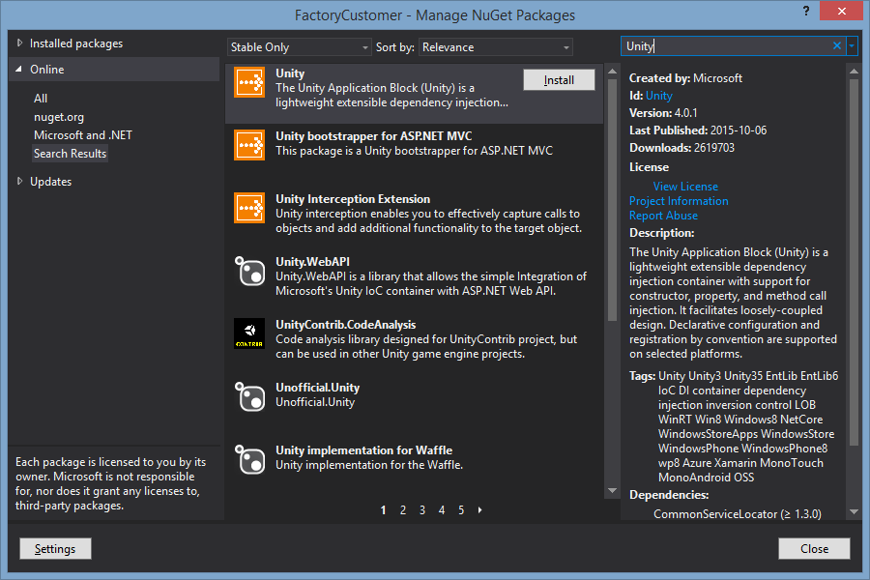

Slide 86


Concept of containers
containers are nothing but collections. “RegisterType” and “Resolve(Type)” methods helps to add and get objects from the container collection respectively.
static IUnityContainer cont = null;
static Factory()
{
cont = new UnityContainer();
cont.RegisterType<ICustomer, Lead>("0");
cont.RegisterType<ICustomer, Customer>("1");
}
public static ICustomer Create(int CustomerType)
{
return cont.Resolve<ICustomer>(CustomerType.ToString());
}

Slide 87
Manual Factory pattern as mapped to Unity Code:
private static List<ICustomer> customers = new List<ICustomer>();
static Factory()
{
customers.Add(new Lead());
customers.Add(new Customer());
}
public static ICustomer Create(int CustomerType)
{
return customers[CustomerType];
}
static IUnityContainer cont = null;
static Factory()
{
cont = new UnityContainer();
cont.RegisterType<ICustomer, Lead>("0");
cont.RegisterType<ICustomer, Customer>("1");
}
public static ICustomer Create(int CustomerType)
{
return cont.Resolve<ICustomer>(CustomerType.ToString());
}

Slide 88
Project: Abstract class
Instantiating the CustomerBase class and calling the Validate method will result in unexpected results. CustomerBase is a half defined class
public class CustomerBase : ICustomer
{
public string CustomerName { get; set; }
public string PhoneNumber { get; set; }
public decimal BillAmount { get; set; }
public DateTime BillDate { get; set; }
public string Address { get; set; }
public void Validate()
{
// To be defined by the child classes
}
}
public abstract class CustomerBase : ICustomer
{
public string CustomerName { get; set; }
public string PhoneNumber { get; set; }
public decimal BillAmount { get; set; }
public DateTime BillDate { get; set; }
public string Address { get; set; }
public abstract void Validate();
}

Slide 89
Project: generic factory
Currently the factory class is coupled with the “Customer” types. In other words if we want to punch out “Supplier” types for example, we would need another “Create” method as shown in the below code. So if we have lot of business objects like this we would end up with lot of “Create” methods.
public static class Factory
{
public static ICustomer Create(int CustomerType)
{
return cont.Resolve<ICustomer>(CustomerType.ToString());
}
public static Supplier Create(int Supplier)
{
return cont.Resolve<ISupplier>(Supplier.ToString());
}
}

Slide 90
Enter Generics
Generics help you to decouple the logic from the data type. The logic here is “Object Creation”, but attaching this logic to only “Customer” would make the architecture rigid. So how about making it a generic type “T” as shown in the below code.
1) Updating the Factory tests:
[TestClass]
public class FactoryTests
{
public readonly string TestLeadType = CustomerScreenTests.TestCustomerTypes.Lead.ToString();
public readonly string TestCustomerType = CustomerScreenTests.TestCustomerTypes.Customer.ToString();
[TestMethod]
public void CreatesNewLeadInstance()
{
…
var result = Factory<ICustomer>.Create(TestLeadType);
…
}
[TestMethod]
public void CreatesNewCustomerInstance()
{
…
var result = Factory<ICustomer>.Create(TestCustomerType);
…
}
[TestMethod]
public void CreatesFreshCloneofCustomerFromFactory()
{
…
var firstResult = Factory<ICustomer>.Create(TestCustomerType);
var secondResult = Factory<ICustomer>.Create(TestCustomerType);
…
}
}

Slide 91
2) Update the FakeCustomerScreen class:
public class FakeCustomerScreen : CustomerScreen
{
public void SetupValues(string customerType, string customerName, string phoneNumber,
string address, decimal billAmount, DateTime billDate)
{
…
3) Update the shim to accommodate the new Create method:
[TestMethod]
public void AddsnewCustomer()
{
//Arrange
var todayTest = DateTime.Now;
using (ShimsContext.Create())
{
//Arrange
var sut = new FakeCustomerScreen();
sut.SetupValues(TestCustomerTypes.Customer.ToString(), ModelTests.TestCustomerName,
ModelTests.TestPhoneNumber, ModelTests.TestAddress, ModelTests.TestBillAmount, todayTest);
ShimFactory<ICustomer>.CreateString = custType => new Customer();
//Act
…

Slide 92
4) Update the Factory
public static class Factory<T>
{
private static readonly Lazy<IUnityContainer> Container = null;
static Factory()
{
Container = new Lazy<IUnityContainer>(LoadContainer);
}
private static IUnityContainer LoadContainer()
{
var cont = new UnityContainer();
cont.RegisterType<ICustomer, Lead>("Lead");
cont.RegisterType<ICustomer, Customer>("Customer");
return cont;
}
public static T Create(string type)
{
return Container.Value.Resolve<T>(type);
}
}
More readable
5) Calling code becomes:
var Icust = Factory<ICustomer>.Create(“Customer”);

Slide 93
Project: Strategy pattern for validation
If we look at the third requirement:
The app must capture 5 fields for now Customer Name, Phone number , Bill Amount , Bill date and Customer Address.
In phase one, two types of customer data are collected. One is a lead and the other is a customer. A lead is a person who comes to My Store but does not buy anything. He just inquires and goes away. A customer is a person who comes and buys things from the shop. A customer actually does a financial transaction.
When it’s a lead, only Customer name and phone number are compulsory, but for a Customer all fields are compulsory. The app should have provision to add new validation rules seamlessly and these validation rules should be flexible and reusable.
We have meet the first part there of, but reading the second part, we are still more static than dynamic with out inheritance. Also our “Customer” and “Lead” models are tightly coupled with our validation algorithm / strategy.

Slide 94
In short:
We are not following S.R.P.
We are not doing S.O.C.
We need to implement I.O.C. by moving the validation logic from the entity classes to some other class.
Now in order to achieve decoupling between “Entity” and “Validation Logic” we need to ensure that both these parties talk via general interfaces rather than talking directly to concrete classes.
Entity
Entity Interface
Validation Interface
Validation Logic

Slide 95
1) Create Unit tests for Validation code and move the tests out of the Model Unit tests:
[TestClass]
public class CustomerValidationTests
{
[TestMethod]
[ExpectedException(typeof(Exception), "Customer Name is required")]
public void ThrowsExpectionOnCustomerNameLengthZero()
{
//Arrange
var sut = new Customer(new CustomerValidation());
//Act
sut.Validate();
}
[TestMethod]
public void DoesNotValidateBillAmountOnLead()
{
//Arrange
var sut = new Lead(new LeadValidation()) { CustomerName = ModelTests.TestCustomerName,
PhoneNumber = ModelTests.TestPhoneNumber };
//Act
sut.Validate();
//Assert
Assert.AreEqual(0m, sut.BillAmount);
}
}
As this is the only place we will be testing validation the constructors on the other Customer / Lead Objects can be injected with “null”
As this is the only place we will be testing validation the constructors on the other Customer / Lead Objects can be injected with “null”

Slide 96
2) General interface for Validation:
public interface IValidationStratergy<in T> //Contravarient type T
{
void Validate(T obj);
}
3) Create Customer Validation:
public class CustomerValidation : IValidationStratergy<ICustomer>
{
public void Validate(ICustomer obj)
{
if (string.IsNullOrEmpty(obj.CustomerName))
throw new Exception("Customer Name is required");
if (string.IsNullOrEmpty(obj.PhoneNumber))
throw new Exception("Phone number is required");
if (obj.BillAmount > 0)
throw new Exception("Bill is required");
if (obj.BillDate >= DateTime.Now)
throw new Exception("Bill date is not proper");
}
}

Slide 97
4) Create Lead Validation:
public class LeadValidation : IValidationStratergy<ICustomer>
{
public void Validate(ICustomer obj)
{
if (string.IsNullOrEmpty(obj.CustomerName))
throw new Exception("Customer Name is required");
if (string.IsNullOrEmpty(obj.PhoneNumber))
throw new Exception("Phone number is required");
}
}

Slide 98
Now the base class will internally point to the general validation interface and the “Customer” and “Lead” class have no idea what kind of validation strategy will they will be executing.
5) Update CustomerBase
public abstract class CustomerBase : ICustomer
{
// Code removed for simplification
private readonly IValidationStratergy<ICustomer> _validationStratergy;
protected CustomerBase(IValidationStratergy<ICustomer> validationStratergy)
{
_validationStratergy = validationStratergy;
}
public void Validate()
{
_validationStratergy.Validate(this);
}
}

Slide 99
6) Customer and Lead classes become:
public class Customer : CustomerBase
{
public Customer(IValidationStratergy<ICustomer> validationStratergy) : base(validationStratergy) { }
}
public class Lead : CustomerBase
{
public Lead(IValidationStratergy<ICustomer> validationStratergy): base(validationStratergy){ }
}

Slide 100
6) Now in the factory class we can create any entity and inject any validation in to it. Customer class has the All validation class object injected into it while the lead class has the lead validation object injected into it.
cont.RegisterType<ICustomer, Lead>("Lead", new InjectionConstructor(new LeadValidation ()));
cont.RegisterType<ICustomer, Customer>("Customer", new InjectionConstructor(new CustomerValidation()));
Full Factory:
public static class Factory<T>
{
private static readonly Lazy<IUnityContainer> Container = null;
static Factory()
{
Container = new Lazy<IUnityContainer>(LoadContainer);
}
private static IUnityContainer LoadContainer()
{
var cont = new UnityContainer();
cont.RegisterType<ICustomer, Lead>("Lead", new InjectionConstructor(new CustomerValidation()));
cont.RegisterType<ICustomer, Customer>("Customer", new InjectionConstructor(new LeadValidation()));
return cont;
}
public static T Create(string type)
{
return Container.Value.Resolve<T>(type);
}
}
Strategy pattern: This is a behavioural design pattern which helps to select algorithms on runtime.

Slide 101
What’s next?
In the next part we would be covering the following five patterns:
Creating DAL layer using ADO.NET and decoupling them using Repository pattern , UOW (Unit of Work) and adapter pattern.
Using template pattern in ADO.NET code to reuse command and connection objects.
Use Façade pattern to simplify UI code.

